Slide 1
Community Health Needs Assessment
Key Findings
Chittenden and Grand Isle Counties
Notes:
Pre-read options: full report, executive summary, and matrix PDFs
CHNA Outreach Team Note Tracker: https://forms.microsoft.com/r/wCV8dDggQu
Quick roundtable intros
Note: Presentation 15-20 minutes with no discussion

Slide 2

Presentation Outline
CHNA Process: Data and Community Engagement
2022 Emerging Health Priorities
Assessment to Action
Notes:
Justin
Introduce Self
Agenda for today
Start with brief overview of the CHNA process
High-level review of the (3) Top- community informed health priorities with an emphasis on Housing
Discuss next steps – moving from the assessment phase to action
Short survey and q&a

Slide 3
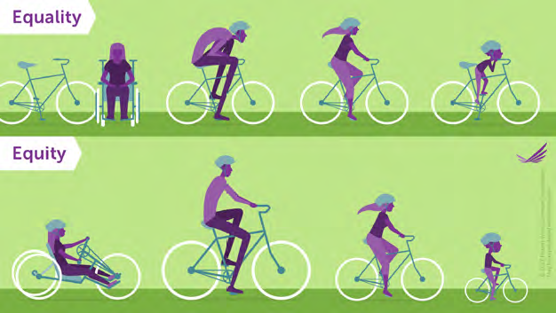
CHNA Process
Key Considerations & Investments
  Recruited diverse, cross-sector steering committee, work groups and advisors
  ‘Health’ broadly defined
  Centered the experiences of structurally marginalized communities
  Designed accessible engagement opportunities
  Multiple data collection methods
Notes:
Justin
CHNA – every 3 years – process facilitated by the UVMMC but community-wide effort
Process was overseen by a 37-member Steering Committee, representing over 25 organizational partners
We Adopted Vermont Department of Health’s broad ‘Health Equity’ definition
Included data on factors that impact equitable opportunities for health:
Built and lived environment
Structural barriers and resources distribution
Religion and spiritual beliefs that effect decision making
Focused on populations often under represented or not represented due to factors like; small sample size, or access barriers to engagement such as materials only being available in English
CHNA Survey is only one aspect to the assessment – also includes 32 KII, focus groups, and 70 secondary health data indicators – YRBS, Census, etc.

Slide 4
Community Health Priorities
Accessible and Coordinated Care
Cultural Humility and Inclusive Health Care
Housing
Food Access
and Security
Mental Health and Wellbeing
Workforce Development
Notes:
Justin
- Through our assessment we identified (6) Community Health Priorities – data and information on all (6) can be found in the full report
Gold Stars indicate the top (3) Emerging Health Priorities that were ratified by the CHNA Steering Committee and that we'll touch on today
Research shows that identifying 1-3 top health priorities is best practice
1-3 priorities best for ‘collective impact’ model – think back to opioid alliance
More strategic and focused community investment
Better direct financial resources with narrower scope
Better develop goals, measures, and track outcomes

Slide 5
2022 Emerging Health Priorities
Notes:
Placeholder slide – for Justin to transition to (3) Emerging Health Priorities

Slide 6
Housing
Notes:
Thomas
From our findings, we summarize 'housing' as having safe and affordable housing that meets the needs of all families and individuals in our community, while ensuring equitable access

Slide 7
Housing
Key Concerns:
Housing availability (low vacancy rates)
Housing affordability (cost-burdened households)
Housing quality and safety
Gap between wages and Fair Market Rent:
  VT minimum wage in 2022: $11.75/hour
  1-bedroom rental: $22.37/hour (HUD)
  2-bedroom rental: $28.85 (HUD)
Notes:
Thomas
Our findings detail a variety of housing-related concerns in Chittenden and Grand Isle counties including:
Availability, affordability, and quality and safety
Concerns are amplified when you look at data disaggregated by race and ethnicity, and socioeconomic status - as illustrated here when looking at Vermont's minimum wage and the wage someone would need to earn to afford an apartment rental
We will discuss more about each of this concerns on the next slides

Slide 8
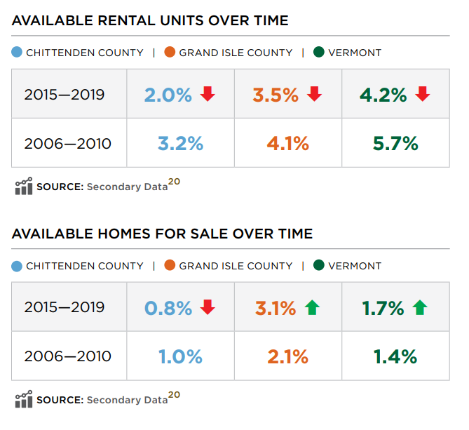

Housing
Notes:
Thomas
This slide speaks to the availability of housing over time in terms of available rental units and homes for sale. The data presented here compares housing availability from 2006-2010 to availability from 2015-2019 across Chittenden County, Grand Isle County and Vermont as a whole. Although the data is not current, it speaks to a continuing trend which makes housing a top health priority.
What we see is:
-Decrease in available rental units over time across the three target areas – Chittenden C, GI and Vermont.
-For available homes for sale – we see a decrease in chttenden county, an increase in GI and an overall increase across the state.
62% of CHNA Community Survey respondents said that increasing affordable housing units will strengthen the physical environment of their community – showing a lot of community awareness around the lack of availability

Slide 9
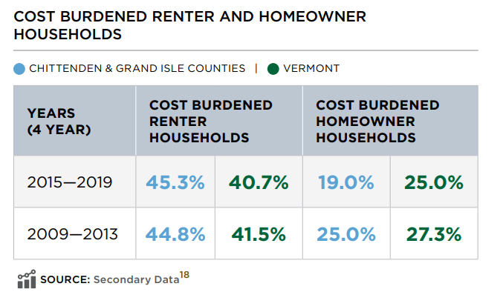
Housing
Notes:
Thomas
Moving from availability to Cost:
This slide speaks to cost burdened renters and homeowner households – cost burdened means that a household is currently in unaffordable housing – 30% or more of their monthly income is spent on housing
Table shows Chittenden and Grand Isle Counties in Blue, State of Vermont in Green
45% of renter households and 19% of homeowner households are living in unaffordable (cost burdened) housing
Observation:
Over time Decrease in cost-burden for home-owners (25% to 19%)
Over Time Increase in cost-burden for renters for Chittenden County (44.8% to 45.3%)
Keeping in mind that renters are more often cost burdened and 1 in 4 housing units or 25% of our housing stock is renter occupied - Our next slide shows home-ownership and renters broken down by race and ethnicity.

Slide 10
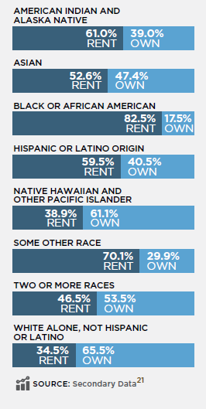
Housing
Notes:
Thomas
Key Findings:
Renting is in dark blue vs. home ownership in light blue for each demographic category
-
White households are most likely to own their homes (65.5%) - with 35 percent renting which is the lowest percentage across each race presented
Black or African American households have the highest percentage in terms of renting (82.5%) and lowest percentage of owning
We know historically and still today, structural racism has led to disparities in homeownership and overall substandard housing conditions. Barriers like red-lining or access to credit, generational wealth building, urban planning and zoning discrimination to name a few structural barriers.

Slide 11
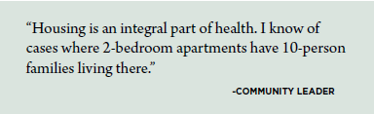
Housing
1 in 6 households experience "severe housing problems"
  Overcrowding
  Having incomplete plumbing or kitchen facilities
  Paying more than 50% of their income for their housing costs
Notes:
Thomas
This last slide speaks to severe housing problems experienced by 1 in 6 of households – which is one of the issues described on this slide. With low vacancy rates, we know that folks have few options for alternative housing
We observed noticeable differences in safe housing by race and ethnicity:
20% of Black, African-American, and Hispanic/Latino respondents reported on our Community Survey not having “safe and healthy housing” as compared to 10% of white-identifying respondents
One Community member stated: “There is a lack of affordable, safe housing. There isn’t decent housing for families or multi-generational households...new builds are not affordable – this all contributes to stress and depression…”
Another community leader stated that being housed is a basic requirement for health and safety and reflected, “if you are housed successfully for a few years, chances are that your access to health, mental health services, and better quality of life will increase.”
We will now transition to touch quickly on the other two health priorities

Slide 12
Cultural Humility and Inclusive Healthcare
Notes:
Justin
Cultural Humility and Inclusive Health Care summarized as:
- Access to inclusive, high quality health care in settings where ALL community members feel safe, respected, and understood.

Slide 13


Cultural Humility and Inclusive Health Care
Key Findings:
Lack of language access services
Lack of diversity within
healthcare workforce
Lack of culturally
competent care
Notes:
Justin
Key Findings/Themes:
Importance of respecting how culture, religion, and spiritual beliefs guide health and wellbeing.
Across data collection methods we observed a lack of culturally competent care such as:
A lack of language access services
A Lack of diversity within the professional healthcare workforce
Community members not feeling safe or understood due to institutional racism (or systems that reinforce racial inequality)
When asked if healthcare providers respect your cultural identity, many community survey respondents reported low levels of agreement, particularly:
- Community members who have lived in the US for 5 years or less
- Community members who are gay, lesbian, bisexual, asexual or queer
- And community members who are transgender, genderqueer non-binary or fluid
Finally,
We heard from older Vermonters and caregivers of children with mental health challenges in a focus groups
Older community members described the importance of feeling Medical Providers listened to their health concerns and priorities, and feeling their concerns were addressed.
Caregivers shared concerns about youth safety and independence and supportive living options for their children when they are no longer available as caregivers
Overall Theme – Important of “Community based resources” and creating shared cultural spaces was also of central importance for promoting physical and mental health across many communities we heard from.

Slide 14
Mental Health and Wellbeing
Notes:
Justin
As we know, Mental Health continues to be a top emerging need in our community and across the state.
Mental health was identified as a top health priority in previous CHNAs completed in 2016 and 2019
We summarized this community priority as: Supporting the mental health and wellbeing of all community members by offering timely services and promoting social connections.

Slide 15

Mental Health and Wellbeing
Data Observations:
1 in 5 adults diagnosed with depressive disorder
Increase in high school students feeling sad or hopeless
Increase in opioid-related deaths and suicide
Additional Themes:
Building Community and Social Connection
Importance of Culture
Addressing social isolation
Supporting Youth Mental Health Conversations
Notes:
Justin
We know that the COVID-19 pandemic has amplified the importance of addressing mental health and wellbeing within the health care system and the community. Community members agree with 65% survey respondents noting that increasing mental health services would strengthen health and wellbeing
Key data observations:
Increases in depressive disorder diagnosis, students feel sad or hopeless,
Increase in opioid related deaths and increased rates of suicide
Barriers and access issues to care
1 out 3 survey respondents disagreed, When asked if mental health services are available in your community;
1 in 4 community survey respondents DID NOT agree that “Substance use treatment resources are available in my community.”
Additionally:
Parents and caregivers of children with mental health challenges shared in a focus group shared overwhelmingly that the current mental health care system in Vermont is not able to adequately support the needs of their children with mental health challenges, and how difficult it is to get help during times of crisis
Additional themes
Importance of social connectedness for supporting mental health and wellbeing.
The need to support youth and schools
Students have questions about how to evaluate their mental health status and wanting social norms to change to normalize conversations about mental health and wellbeing
The positive effect of connecting with others who understand you, your culture, and who have had similar lived experiences

Slide 16

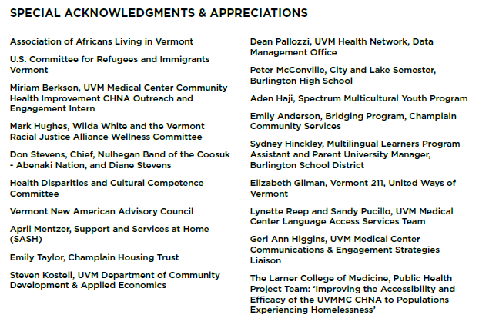
Our Partners for the CHNA
Notes:
Justin
Call out to Community Assests!
Although there is a lot of need, there is a lot of great work happening.

Slide 17
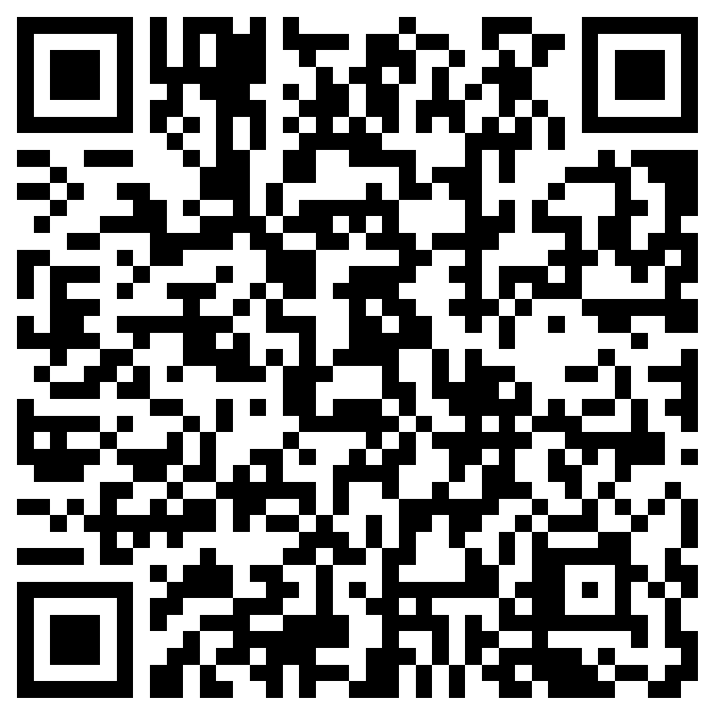
Notes:
Survey – printed versions available
Sarah to send out meeting minutes -
Chanel to post link in zoom

Slide 18
Moving from Assessment to Action
Notes:
Justin
Our first step in moving from assessment to action is sharing out the data and key findings that we’ve observed.
Simultaneously, our team has started working on the Community Health Improvement plan, which I will briefly share more about now and opportunities for collaboration

Slide 19
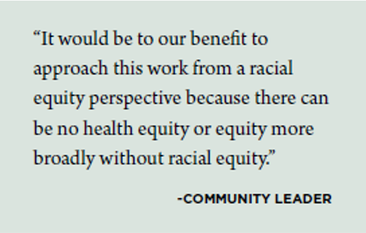
Creating Community-Driven Solutions
Develop CY23-25 Community Health Improvement Plan (CHIP):
  Work from robust asset mapping
  Generate shared solutions with partners
Guide investments
  $1 million (annual) Community Health Investment Fund
Notes:
Justin
- Our Community Benefits Team is facilitating the development of the CHIP - (3) year plan centered around the health priorities
CHIP will:
- Spark community partner collaboration to develop shared solutions
- emphasize health equity, ensuring that the plan is informed by community members most impacted by the priorities
- Inform programmatic decisions and guide investments, like our $1million+ annual Community Health Invesment Fund
CHIP Governance
- Chittenden Accountable Community for Health to advise, support and implement community-based initiatives
- Action Teams for each top health priority
Post Survey: https://forms.microsoft.com/r/A1FXnqXDV1

Slide 20
Thank you!
Kristin Fontaine, Pediatric Outreach Coordinator
Justin Graham, Community Health Project Coordinator
Notes:
Add your contact info on slide
Thank you, and we look forward to hearing your reflections, and guidance as we move forward to address these top priorities

Slide 21
Brief Discussion
How do these findings land with you?
Did anything stand out or surprise you?
Notes:
Kristin
Post Survey: https://forms.microsoft.com/r/A1FXnqXDV1
How do these findings land with you?
Did anything stand out or surprise you?
Where are you taking action to address these health priorities?

